Slide 1



Discover the Wonders of Natural Language Processing!

Slide 2
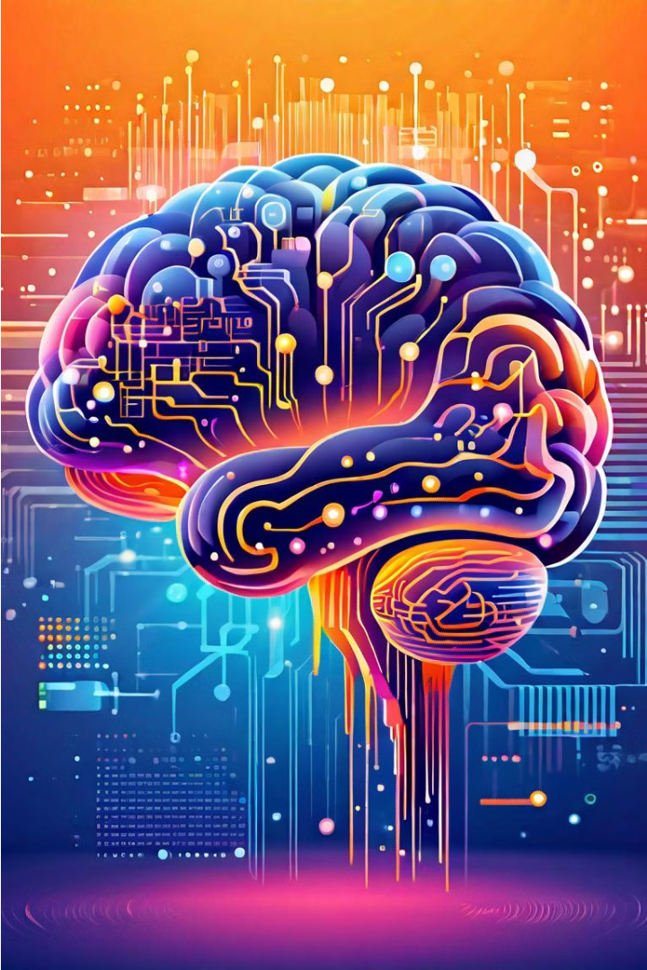
Introduction to Natural Language Processing
Natural Language Processing (NLP) is a field of artificial intelligence that focuses on enabling computers to understand, interpret, and generate human language. It allows machines to analyze, comprehend, and respond to text or speech in a way that mimics human communication.

Slide 3
Use cases of NLP
Language Translation
Sentiment Analysis
NLP enables real-time translation between languages, breaking down communication barriers and facilitating global collaboration.
NLP can detect the emotional tone of text, providing valuable insights for customer experience, brand monitoring, and more.
Chatbots and Virtual Assistants
Text Summarization
NLP powers conversational AI that can understand and respond to human language, automating customer service and support.
NLP can extract the key points from lengthy documents, saving time and improving information processing.

Slide 4

Tokenization
Tokenization is the process of breaking down text into smaller, meaningful units called tokens.
Tokens can be individual words, punctuation marks, or other linguistic elements that carry semantic meaning.
Tokenization is a crucial step in natural language processing, as it helps machines understand and analyze the structure and meaning of text.

Slide 5

Text Preprocessing with NLTK
In natural language processing, text preprocessing is a crucial step to prepare raw text data for analysis. NLTK, the Natural Language Toolkit, provides powerful tools for stemming and lemmatization - reducing words to their base forms to improve performance of downstream NLP tasks.
Stemming simplifies words by removing suffixes, while lemmatization uses linguistic knowledge to identify the dictionary form of a word. Both techniques help normalize text, reducing data sparsity and improving the accuracy of tasks like sentiment analysis, named entity recognition, and topic modeling.

Slide 6
Deep Learning in NLP
Neural Networks
1
Deep learning models like recurrent neural networks and transformers have revolutionized natural language processing, enabling more accurate language understanding and generation.
2
Language Models
Pretrained language models like BERT and GPT-3 capture deep contextual understanding of language, powering applications from chatbots to text summarization.
Sequence-to-Sequence
3
Seq2seq architectures enable complex language tasks like machine translation, question answering, and text generation by modeling the input-output relationship.

Slide 7
Stopword, Part of speech, Entity recognition
Stopwords
Part of Speech
Entity Recognition
Stopwords are common words like "the", "a", "and" that are often removed from text to improve natural language processing. This helps focus on more meaningful words.
Identifying the part of speech, such as noun, verb, adjective, etc., is crucial for understanding the grammatical structure and meaning of text.
Entity recognition is the process of identifying and classifying named entities in text, such as people, organizations, locations, and dates. This provides important context.

Slide 8
Encoding
1
Numerical Representation
2
One-Hot Encoding
Encoding converts text data into numerical representations that can be processed by machine learning models.
This method creates a sparse vector with a single 1 indicating the presence of a word, while all other elements are 0.
3
Label Encoding
4
Ordinal Encoding
Labels are assigned unique numerical values to represent categorical variables, enabling models to understand relationships between them.
This encoding preserves the order of categorical variables, assigning sequential numbers based on the inherent ranking.

Slide 9



Embedding, word2vec
Text Representation
Neural Networks
Semantic Similarity
Word2vec is a technique for representing words as numerical vectors, capturing semantic and syntactic relationships between words.
Word2vec uses neural networks to learn these word embeddings from large text corpora, allowing machines to understand the meaning and context of words.
The vector representations allow for measuring the semantic similarity between words, powering applications like text classification, sentiment analysis, and information retrieval.

Slide 10
Skipgram
Context
1
Word2Vec uses two architectures: Continuous Bag-of-Words (CBOW) and Skip-gram.
Skip-gram
2
The Skip-gram model predicts the surrounding words given a center word.
Advantages
3
Skip-gram performs better on infrequent words and can capture more subtle semantic relationships.
The Skip-gram model in Word2Vec is a neural network architecture that learns word embeddings by predicting the surrounding context words given a center word. Unlike CBOW, which predicts the center word from the context, Skip-gram does the reverse, making it more effective at capturing subtle semantic relationships between words.

Slide 11

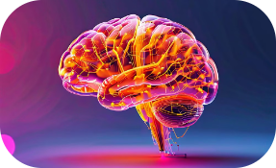


Futures in NLP
Intelligent Assistants
Advancements in Healthcare
Universal Translation
Generative NLP
Advancements in generative models will enable AI systems to create original content, from novels to poetry, by learning from vast datasets of human-written text.
NLP will power the next generation of intelligent digital assistants, capable of engaging in human-like conversations and understanding natural language commands.
NLP will revolutionize medical diagnosis and treatment by enabling AI systems to analyze patient records, symptoms, and research to provide personalized insights.
Seamless real-time translation between languages will break down communication barriers, facilitating globalization and international collaboration.

